Slide 1



Day 08
contact@anubhavtrainings.com
ABAP RESTFUL APPLICATION PROGRAMMING

Slide 2

Agenda – Day 08
What is ABAP git
Configure ABAP git for your system
ABAP git scenario
User types
Capabilities
What is data Analytics
Terminologies in analytics
When to use What?
Working with Analytic List Page
Working with OVP Application
Cross App navigation from OVP
SAP S/4HANA Embedded Analytics
SAP S/4HANA Embedded Analytics – Architecture
KPI Modeling
Multi Dimensional Modeling

Slide 3
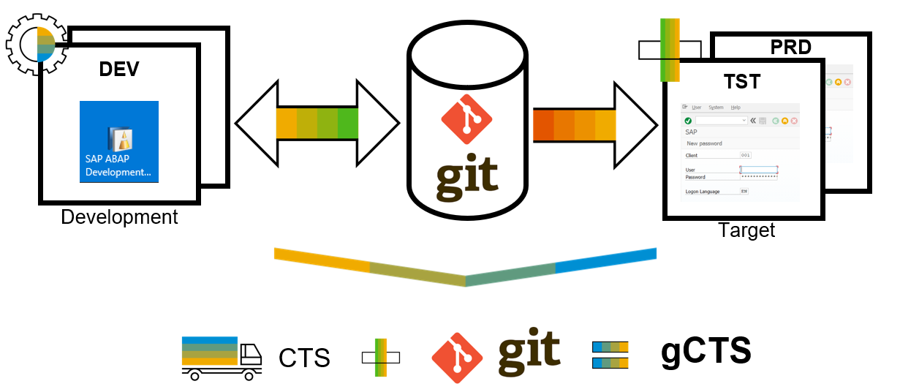
What is ABAP Git ?
abapGit is a tool to import and export code between ABAP systems. If a developer has a developer key to the system, the developer can perform these actions already. abapGit enables the developer to do mass export/changes/imports but not more than already possible to do manually.
Running automated security checks on the abapGit code will by design give a lot of errors, as abapGit will import, overwrite and change ABAP artifacts in the system in ways that might not be intended. Always review all code in remote repositories before importing to the target system, this is possible because abapGit is plain text unlike traditional transport files.
That being said, abapGit is used by mutiple organizations, all abapGit changes are reviewed via pull requests. And all 100+ repository watchers are automatically notified for every change to the code base, so potentially all changes are looked at by more people than tradtional enterprise products.

Slide 4
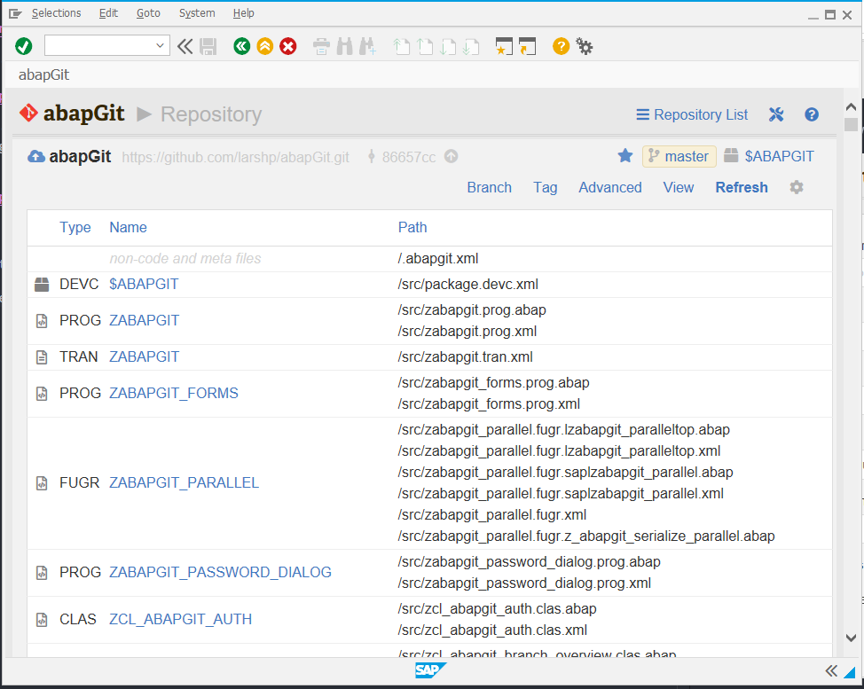
ABAP Git
It is a community effort to support the project, recommend watching the project to get a feeling about issue resolution. Everyone can suggest changes to abapGit via pull requests.

Slide 5
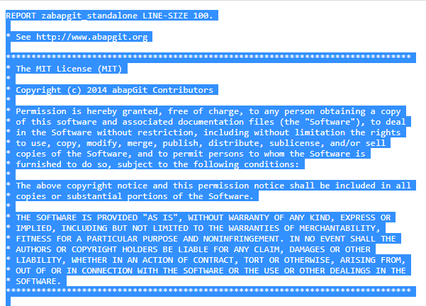
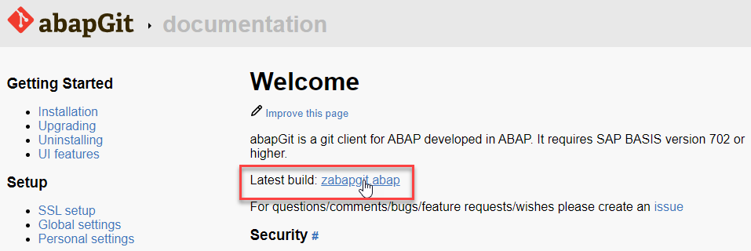
ABAP Git Integration
Step 1. Go to https://docs.abapgit.org/ in browser and click on Latest Build.
Step 2. Copy this Code.

Slide 6
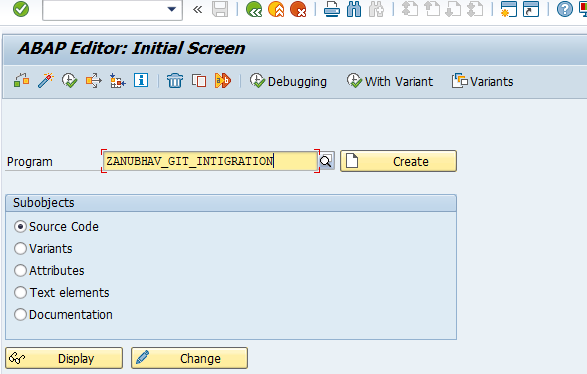
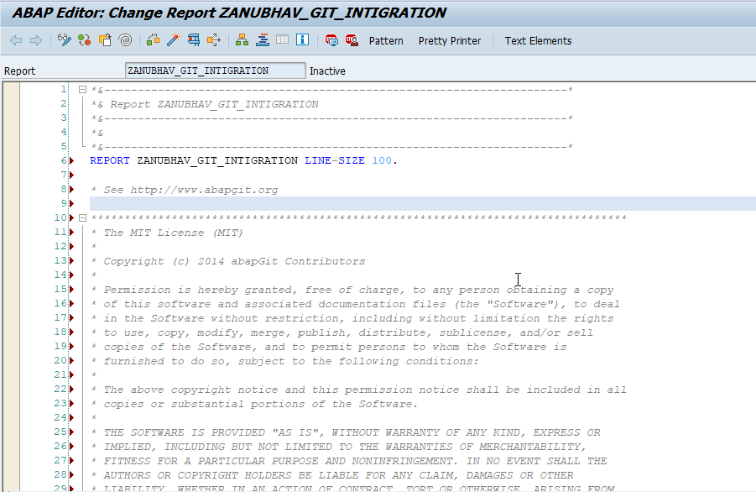
ABAP Git Integration
Step 3. Open SAP Gui Go to T-Code SE38 for Building Report, give any name to report and click on create.
Step 4. Paste the Copied Copy in this report.

Slide 7
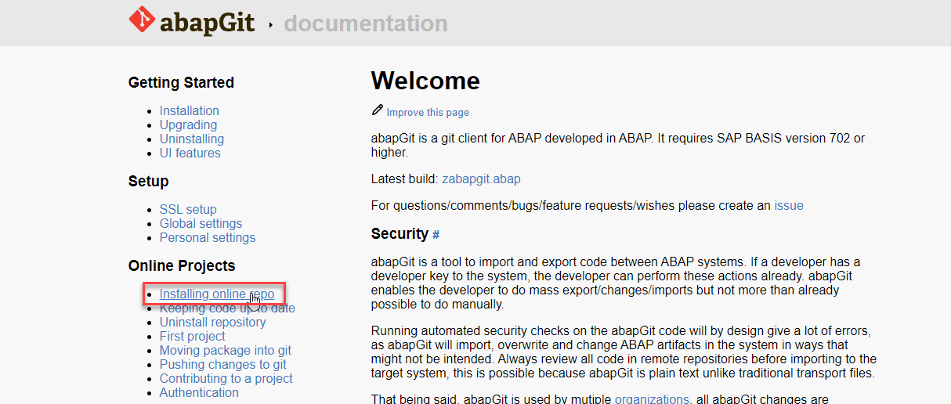
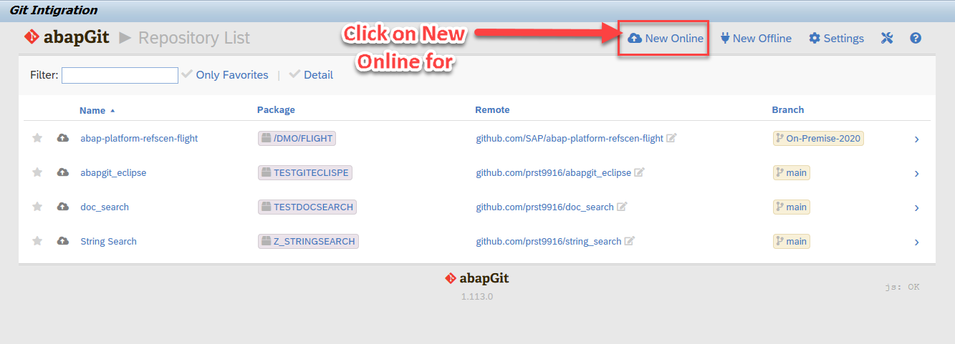
ABAP Git Integration
Step 5. After the Execution, abapGit Screen
Step 6. Go back to Bowser side and click on Installing Online Repo

Slide 8
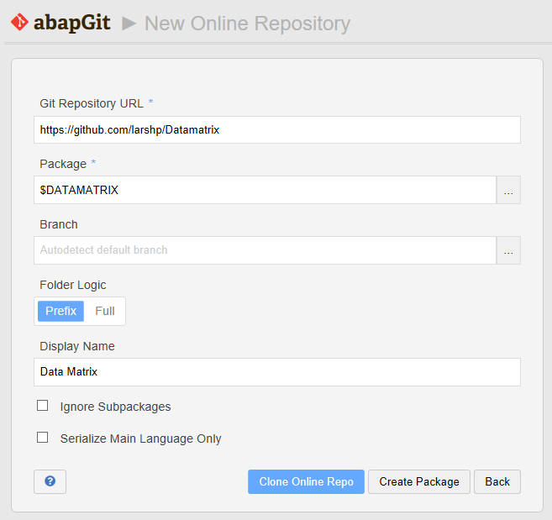
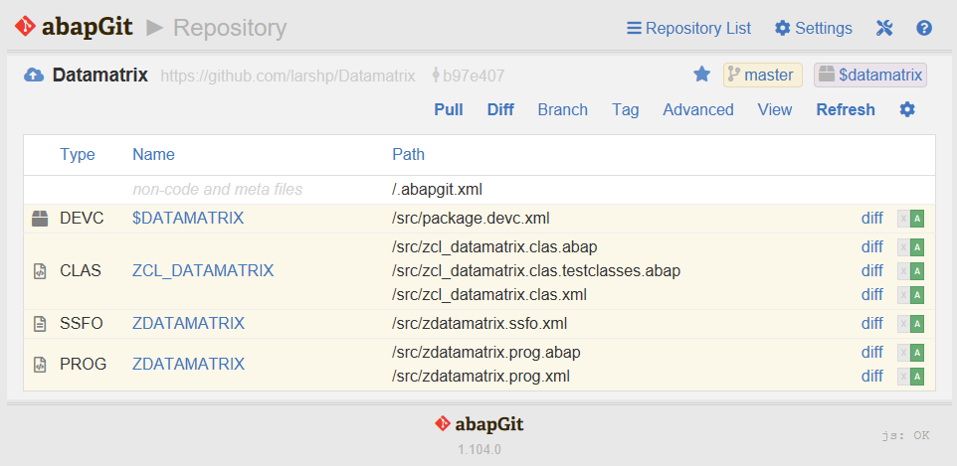
ABAP Git Integration
Step 7. Enter the url for the Github project, eg https://github.com/larshp/Datamatrix along with a package name, eg. $DATAMATRIX. If the package does not exist yet, it will be created automatically when pulling. Alternatively, you can select “Create Package” to create the package manually with your own settings.
Step 8.Select “Clone Online Repo”
Select “Pull” to copy all objects from the Git repository into the SAP system

Slide 9
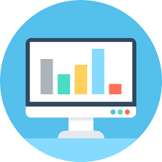
What is data analytics?
Data analysis focuses on the process of examining past data through business understanding, data understanding, data preparation, modeling and evaluation, and deployment. It is a subset of data analytics, which takes multiple data analysis processes to focus on
why an event happened and
what may happen in the future based on the previous data.
Data analytics is used to formulate larger organization decisions.
Data analytics is a multidisciplinary field. There is extensive use of computer skills, mathematics, statistics, the use of descriptive techniques and predictive models to gain valuable knowledge from data through analytics. There is increasing use of the term advanced analytics, typically used to describe the technical aspects of analytics, especially in the emerging fields such as the use of machine learning techniques like neural networks, decision trees, logistic regression, linear to multiple regression analysis, and classification to do predictive modeling.

Slide 10
Terminologies?
Customer Master
Dimension
Product Master
Dimension
CID | Name
A | Apple
B | SAP
C | Oracle
CID | Name
P1 | Laptop
P2 | iPhone
P3 | Projector
Transactional data – Facts
KPI – Key performance indicator – Measure
Measure is always a number but not every number is a measure
ORD_ID | CUST_ID | PROD_ID | EMP_ID | AMT | CURR
10 | A | P1 | E1 | 500 | EUR
20 | B | P2 | E1 | 700 | EUR
30 | A | P2 | E1 | 1000 | EUR
40 | C | P1 | E2 | 800 | EUR
50 | B | P2 | E3 | 900 | EUR
Apple 1500
SAP 1600
Oracle 800
Employee Master
Dimension
Total Sales
Time
CID | Name
E1 | Anurag
E2 | Sneha
E3 | Ananya

Slide 11
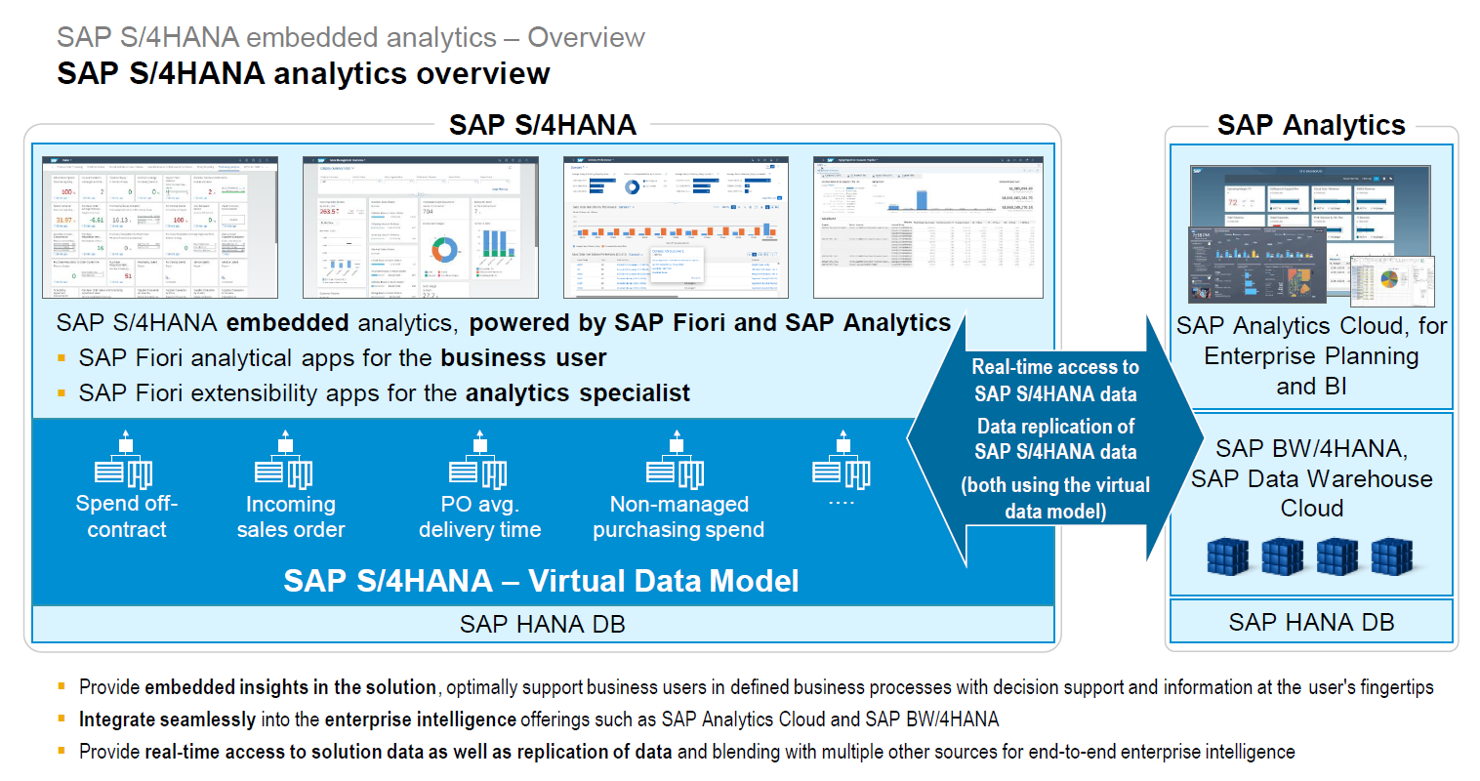
Overview

Slide 12
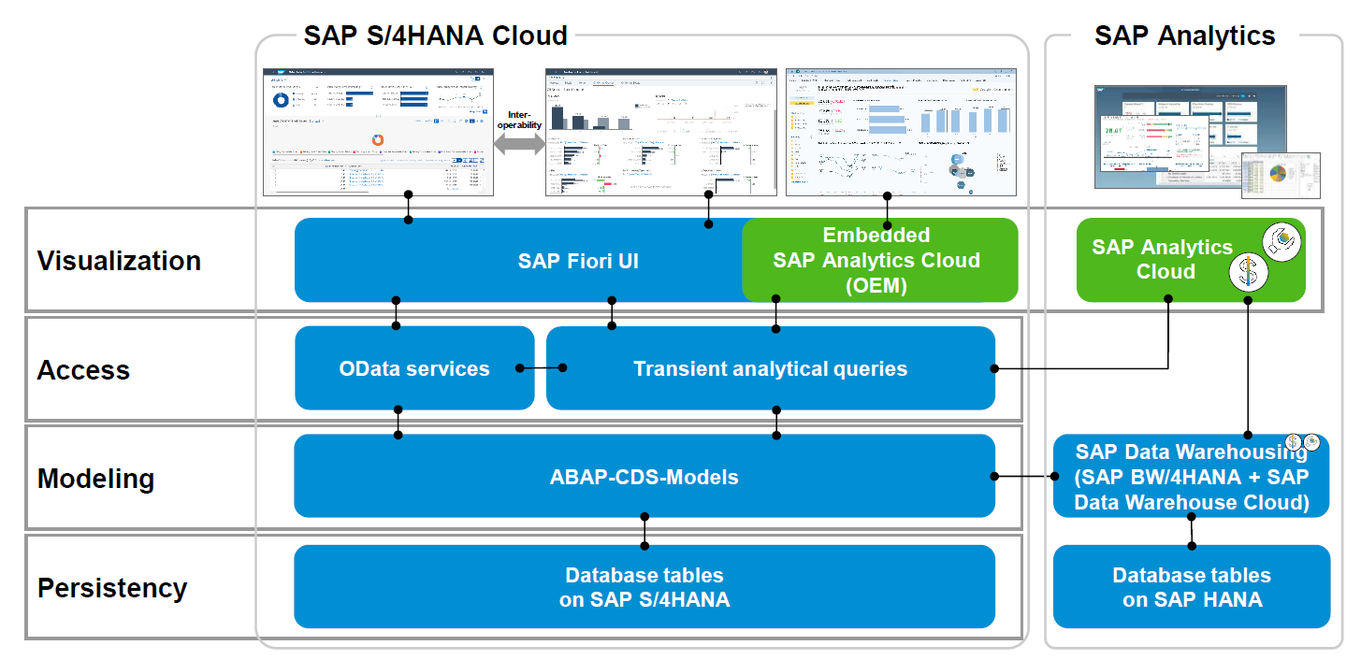
Architecture

Slide 13
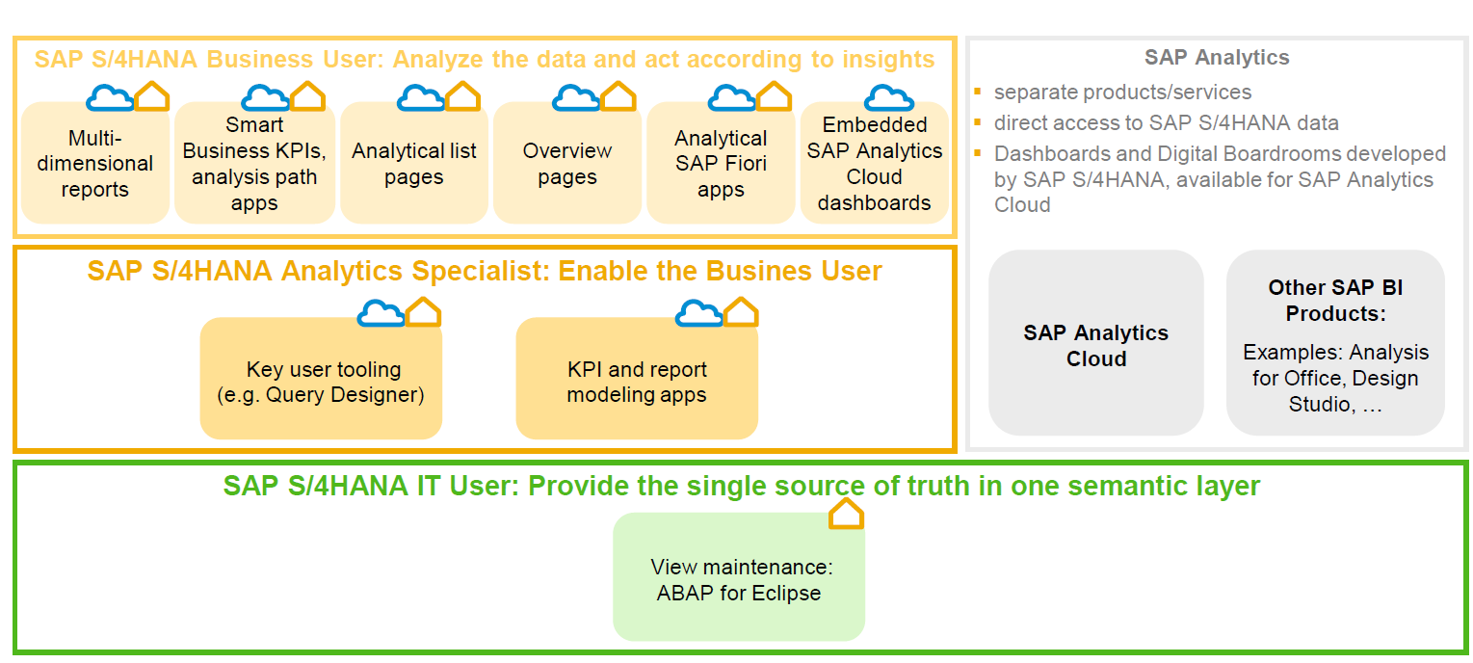
User types

Slide 14
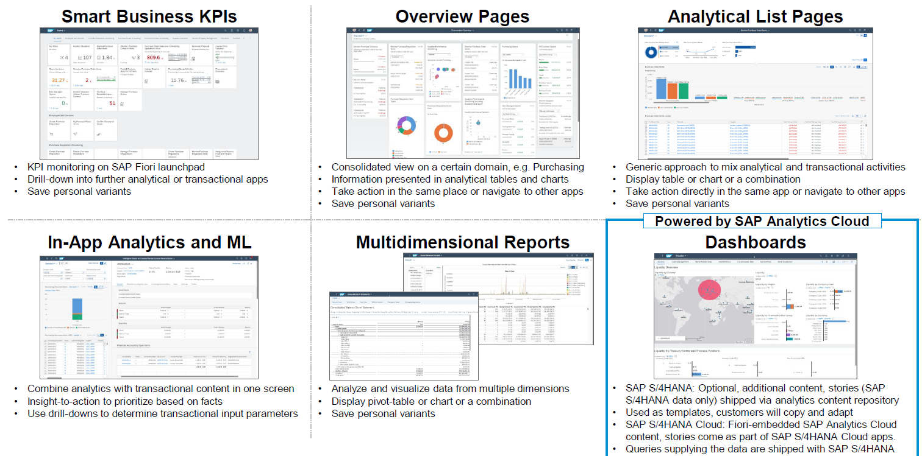
Capabilities

Slide 15
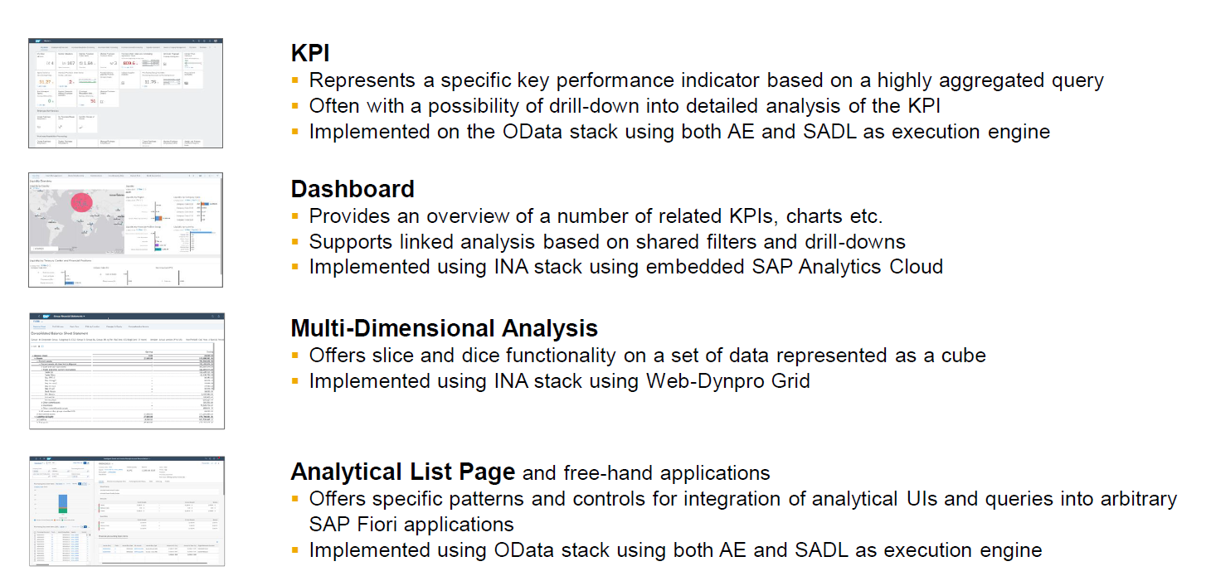
When to use what?

Slide 16
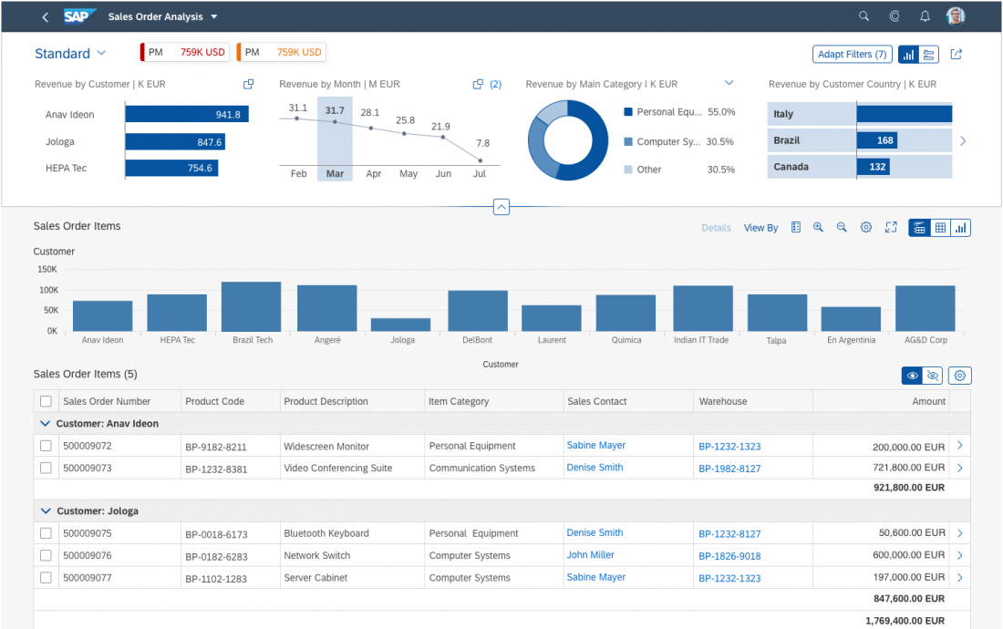
Working with Analytic List Page
The analytical list page (ALP) offers a unique way to analyze data step by step from different perspectives, to investigate a root cause through drilldown, and to act on transactional content. All this can be done seamlessly within one page.
The purpose of the analytical list page is to identify interesting areas within datasets or significant single instances using data visualization and business intelligence.
Visualizations help users to recognize facts and situations, and reduce the number of interaction steps needed to gain insights or to identify significant single instances. Chart visualization increases the joy of use, and enables users to spot relevant data more quickly.

Slide 17
When to use ALP
Users need to extract key information to understand the current situation or identify a root cause. The way the data is presented is crucial for giving them the insights they need to take the right action.
Users need a way to analyze data step by step from different perspectives, investigate a root cause through drilldown, and act on transactional content within one page.
In addition to the filtered dataset, users need to see the impact of their filter settings in a chart (visual filter).
Users need to switch between integrated chart and table views (hybrid view).
Users need to see the impact of their action on a global key performance indicator (KPI).
Users need to find and act on relevant items out of a large set of items by searching, filtering, sorting, grouping, drilling down, and slicing and dicing.

Slide 18
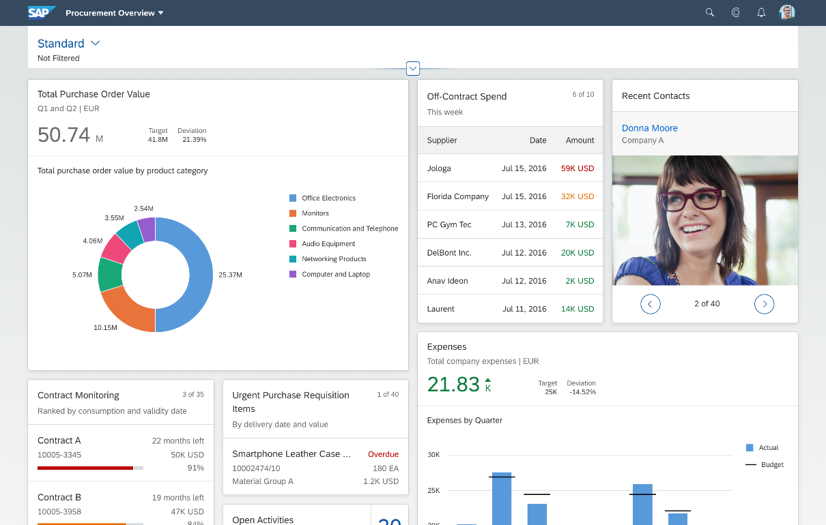
Working with Overview Page (OVP)
The overview page (OVP) is a data-driven SAP Fiori app type and floorplan that provides all the information a user needs in a single page, based on the user’s specific domain or role. It allows the user to focus on the most important tasks, and view, filter, and react to information quickly.
Each task or topic is represented by a card (or content container). The overview page acts as a UI framework for organizing multiple cards on a single page.
The overview page is based on SAP Fiori elements technology, and uses annotated views of app data, meaning that the app content can be tailored to the domain or role. Different types of card allow you to visualize information in an attractive and efficient way.

Slide 19
When to use OVP
You want to provide an entry-level view of content related to a specific domain or role.
Users needs to filter and react to information from at least two different applications to complete their role-specific tasks.
You want to offer different information formats (such as charts, lists, and tables) on a single page.
You plan to have at least three cards. These cards should not all be of the same type.

Slide 20
KPI Modeler
KPI modeler is a framework available in SAP S/4HANA, leverages the odata services and data models which are pre-delivered by SAP. It can be used to design powerful KPI reports to show analytics to the user in multi-dimension.
KPI Definition
(Measure)
Evaluation
(presentation)
1 … *
Drill Down reports
Controls to use Chart,table
1 … *
1 … 1
Data Source
Tile

Slide 21

Use Case
We are working in a manufacturing co. our co. is producing toys, we are delivering these toys via our own shipping channel. But when we have orders coming to us, we are packing and shipping them but we have complaints from buyers that orders are not reaching to them. Basically these supply chain it getting affected due to many reasons.
e.g.
Packaging damaged
Delay due to transport
Lockdown issue
…
My management wants to see all possible order issues (count) with the category of issues.
Also they want to see a tile with chart showing threshold values.
Also we want to allow filtering of these issues per category based on Sales Organization, issue category and Order category.
Investigate the services offered:
Already an odata service : SD_SOFM_SRV
Entity Set Name: SalesOrderFulfillmentIssueQuerySet
Properties:
Dimension: IssueName
Measure: NmbrOfAllIssues
Filters: SalesOrganization, IssueCategory, ManufacturingOrderCategory
www.anubhavtrainings.com

Slide 22
Multi-Dimension Modeling
Data analytics is very important for businesses to know about the ongoing track of the transactions w.r.t the master data. Using data analytics the decision makers in our company take critical actions based on the overview of the data. The cds views are key ingredients to build data analytics in SAP systems.
Use Case
In our company we have the sales data maintained, my business wants to analyze this massive sales data and produce some insights about
Total sales in each currency per country
Total sales in each currency per Customer
Total sales in each currency per product
1. Total sales in each currency per category

Slide 23
Title

Slide 24
Title

Slide 25

End of Day 08
Trainer: Anubhav Oberoy

Slide 26
Trainer: Anubhav Oberoy

Slide 27
THANK YOU
If you cannot do
great things, do small things in a great way.
Anubhav Oberoy
https://www.anubhavtrainings.com

Slide 28


We’re committed to empower you to be
Most Desirable Resource
through powerful training solutions.
We build the workforce of the future.
250+
Corporate Clients
30,000+
Learners Trained
25000+
Learners Placed
FREE WEBINARS
Sign up for free webinars with industry experts every fortnight!
Enroll Now!
Contact us today!
https://anubhavtrainings.com/

Slide 29




More from AnubhavTrainings.com

